Slide 1
Week- 5
Agenda:
Services, Dependency injection, integration with component
Observables
Http Module
Error handling

Slide 2
Angular Services
Angular Services are singleton objects that are instantiated only once during the lifetime of an application. They contain methods that can be used across different components.
They are used to share data and functionality across components, promoting DRY (Don't Repeat Yourself) principles and enhancing code modularity and reusability.
Dependency Injection
Services are defined by a TypeScript class, and the @Injectable()decorator marks it as available to an injector for instantiation, making it a candidate for dependency injection.

Slide 3
Angular Services
Why Angular Services?
Code Reusability: Services allow the same piece of code to be used across multiple components.
Separation of Concerns: Services help in separating the business logic from the components, making the components lean and focused on the UI.
Ease of Maintenance: Centralizing application logic within services makes it easier to update and maintain.

Slide 4
Angular Services
Creating a Service
CLI Command: ng generate service <service-name>
This creates a service file <service-name>.service.ts with a basic skeleton.
Decorator: The @Injectable() decorator is used to define a service, indicating it can be injected into components and other services.

Slide 5
Angular Services
Dependency Injection in Angular:
Dependency Injection (DI) is a design pattern in which a class requests dependencies from external sources rather than creating them. Angular's DI framework provides dependencies to a class upon instantiation
Injector: The main job of an injector is to create dependencies and maintain a container of dependency instances that it reuses if possible. Angular creates and uses injectors implicitly.
Provider: A provider tells an injector how to obtain or create a dependency. In Angular, services are typically provided using the providedIn property of the @Injectable() decorator, which makes the service available application-wide.
@Injectable({
providedIn: 'root'
})
export class ExampleService {
constructor() { }
}

Slide 6
Angular Services
Using a Service in a Component
Import the Service: Include the service in your component by importing it.
import { MyService } from './my.service’;
Inject the Service: Add the service to the component's constructor for dependency injection.
constructor(private myService: MyService) {}
Use the Service: Utilize methods and properties of the service.
ngOnInit()
{
this.myService.someMethod().subscribe(data => { // Use data here });
}

Slide 7
Angular's HTTP Module
Enables HTTP communication with backend services.
Uses Observables for handling asynchronous requests and responses.
Supports a wide range of HTTP operations (GET, POST, PUT, DELETE, etc.).

Slide 8
Angular's HTTP Module
Key Features of HTTP Module
HttpClient: The main class for sending and receiving HTTP requests and responses.
HttpHeaders: Represents the header configuration options for an HTTP request.
HttpResponseType: Enumerates the types of response bodies (e.g., 'arraybuffer', 'blob', 'json', 'text’).
HttpParams: Supports HTTP request parameters.
Interceptors: Intercept requests or responses before they are handled by then or subscribe.

Slide 9
Angular's HTTP Module
Setting Up HTTP Module
Import HttpClientModule: Add to the imports array in the AppModule.
import { HttpClient} from '@angular/common/http’;
Inject HttpClient: Use in services for making HTTP requests.
constructor(private http: HttpClient) { }

Slide 10
Angular's HTTP Module
HTTP GET Example
fetchData(): Observable<any> {
return this.http.get('https://api.example.com/items’);
}
HTTP POST Example
createItem(item: Item): Observable<Item> {
return this.http.post<Item>('https://api.example.com/items', item);
}
HTTP PUT Example
updateItem(id: string, item: Item): Observable<Item> {
return this.http.put<Item>(`https://api.example.com/items/${id}`, item);
}
HTTP DELETE Example
deleteItem(id: string): Observable<any> {
return this.http.delete(`https://api.example.com/items/${id}`);
}
HTTP PATCH Example
partialUpdateItem(id: string, patch: Object): Observable<Item> {
return this.http.patch<Item>(`https://api.example.com/items/${id}`, patch);
}

Slide 11
Observables
Observables play a crucial role in handling asynchronous operations within Angular applications, especially in conjunction with the HTTP module for making HTTP requests.
What is an Observable?
An Observable is a core concept borrowed from the Reactive Programming paradigm, implemented in Angular through the RxJS (Reactive Extensions for JavaScript) library. It represents a stream of data or events over time that can be observed.

Slide 12
Observables
In the HTTP methods (GET, POST, PUT, DELETE, PATCH), each method of the HttpClient returns an Observable.
This Observable, when subscribed to, will send the HTTP request, emit the response when it arrives, and then complete.
Example (GET Request):
fetchData(): Observable<any> {
return this.http.get('https://api.example.com/items’);
}
this.fetchData().subscribe(
data => console.log(data), // Handles next event
error => console.error(error), // Handles error
() => console.log('Completed') // Handles completion
);

Slide 13
Observables
Key Characteristics of Observables:
Asynchronous Data Handling: Observables provide a powerful model for dealing with asynchronous data, such as user input, timers, and, most pertinently, HTTP requests.
Lazy Execution: Observables do not start emitting data until an observer subscribes to them. This contrasts with Promises, which are eager and start executing immediately upon creation.
Cancellation Support: Observables support the cancellation of in-flight HTTP requests. This is particularly useful for scenarios like search-as-you-type features, where you may want to cancel previous requests as new input arrives.
Operators: RxJS provides numerous operators that can be used to transform, filter, combine, or otherwise manipulate the streams of data that Observables represent.

Slide 14
Error Handling in Angular
Error handling is crucial for maintaining application stability.
Angular uses RxJS Observables for managing asynchronous data streams, including HTTP responses.
RxJS provides operators like catchError for handling errors in these streams.

Slide 15
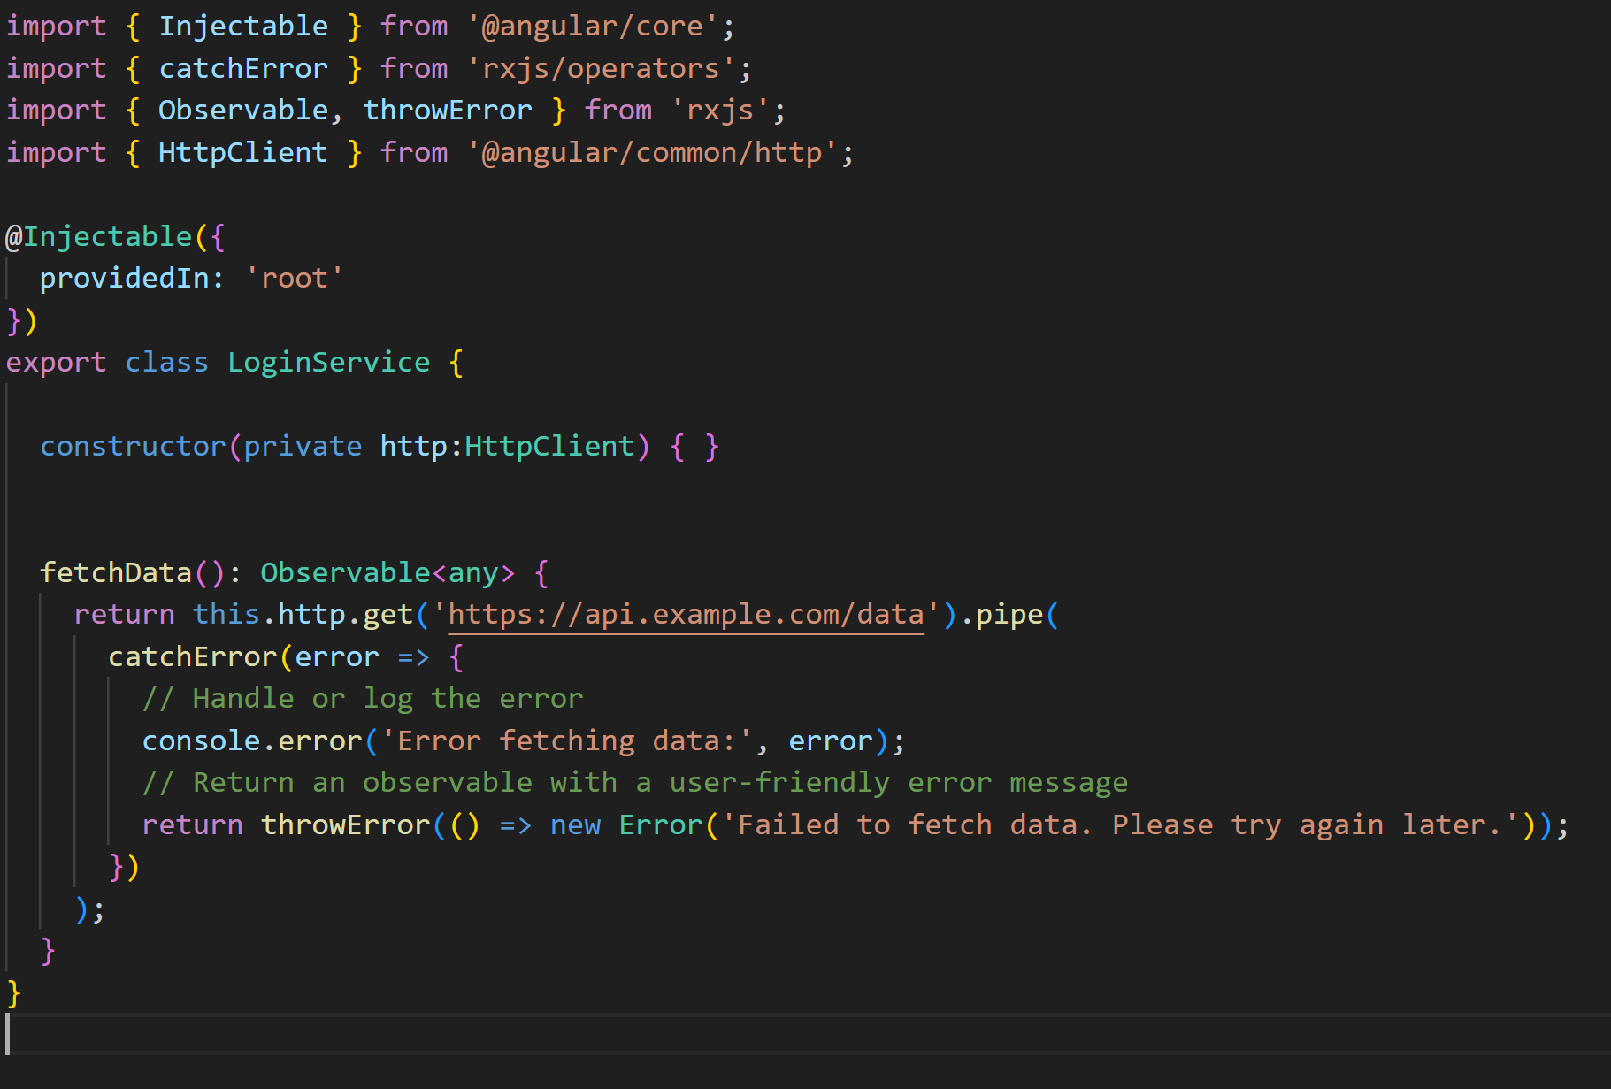
Error Handling in Angular
Example :

Slide 16
Error Handling in Angular
The catchError operator intercepts errors that occur during the Observable stream.
Inside catchError, you can handle the error (e.g., logging) and return a new Observable or throw an error.
throwError is used to return an Observable that emits an error, which can be further handled by the subscriber.

Slide 17
Error Handling in Angular
Advantages of Centralized Error Handling
Simplifies error handling by centralizing logic in services or interceptors.(Global Error Handling)
Improves user experience by providing consistent error responses.
Facilitates easier maintenance and updates to error handling logic.

Slide 18
Thank you

